Slide 1


UAP FOOTBALL LEAGUE
PRESENTED BY
SHOUROV CHONDRO BORMON SHAH ABUL HASNAT SHAMS SHAHRIAR HAQUE
ID: 22201028 ID: 22201052 ID: 22201041
SEC - A2 SEC- A2 SEC-A2
SUBMITTED TO
ALIF RUSLAN
LECTURER
DEPARTMENT OF CSE
UNIVERSITY OF ASIA PACIFIC

Slide 2
Project Objectives :-
To design a robust database to store league data.
Enable efficient querying for analysis and reporting.
To insights into player performance and team success.
DataBase Structure: Our Database has five tables
Team
Player
Player_Statistics
Matches
League_Standings
Each table represents a specific aspect of the league, and together, they form an interconnected system.

Slide 3
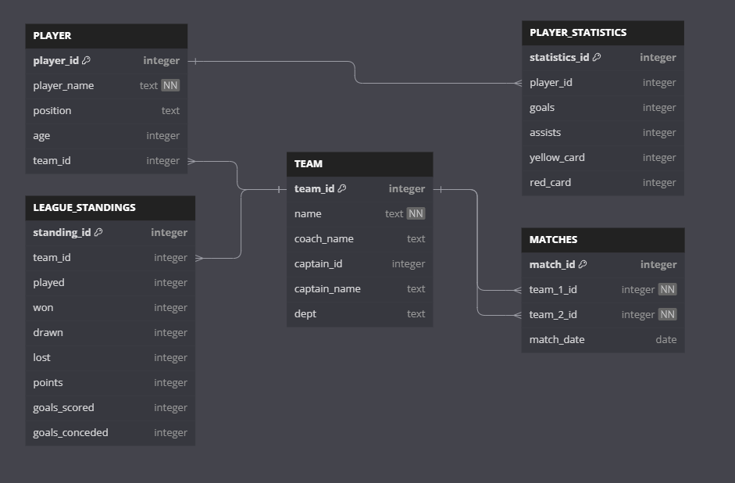
Schema Diagram

Slide 4
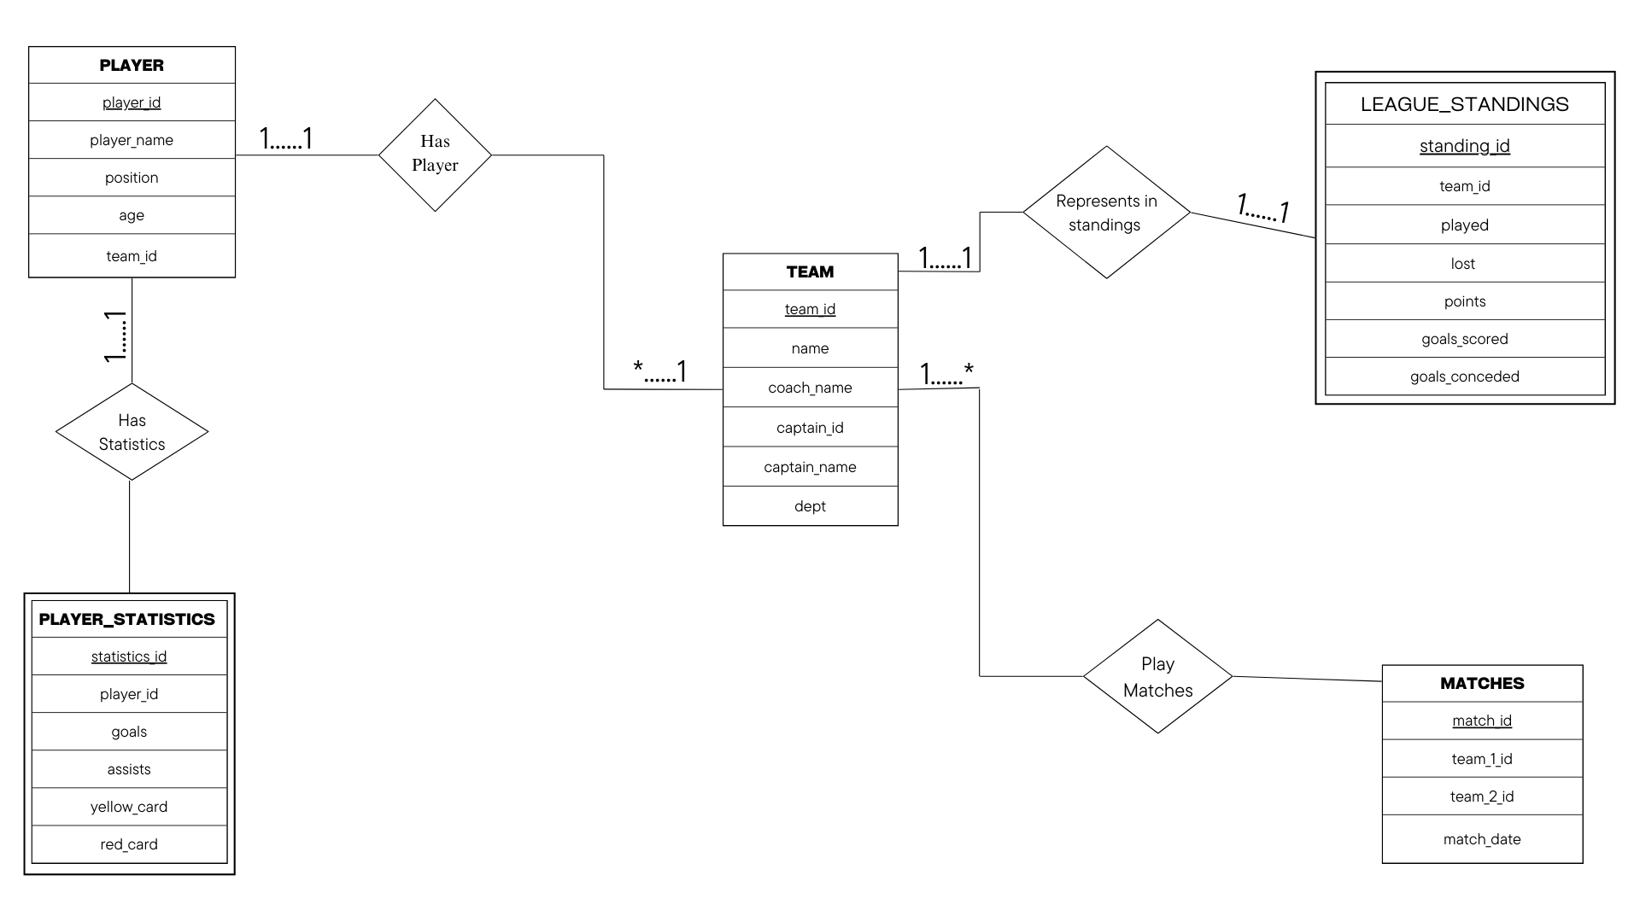
Entity Relationship Diagram

Slide 5
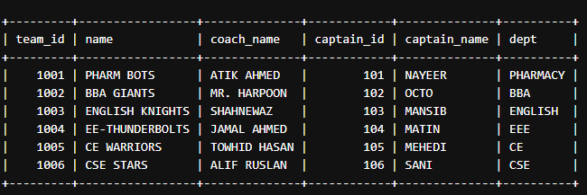
TABLES
1
Team

Slide 6
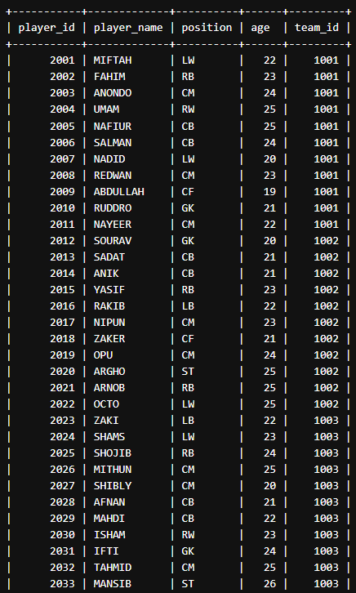
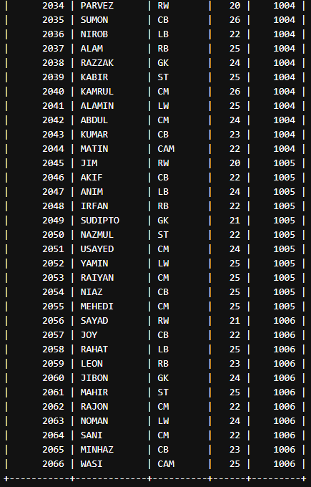
PLAYER
2

Slide 7
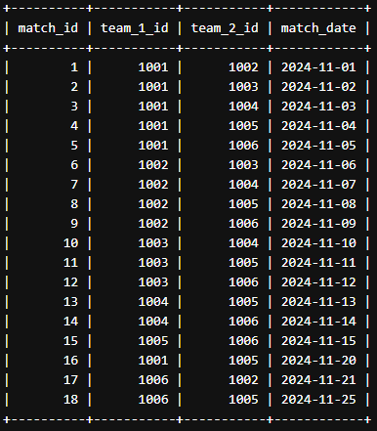
3
MATCHES

Slide 8
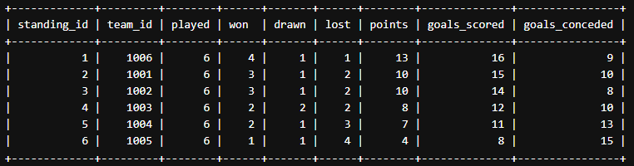
4
LEAGUE STANDING TABLE

Slide 9
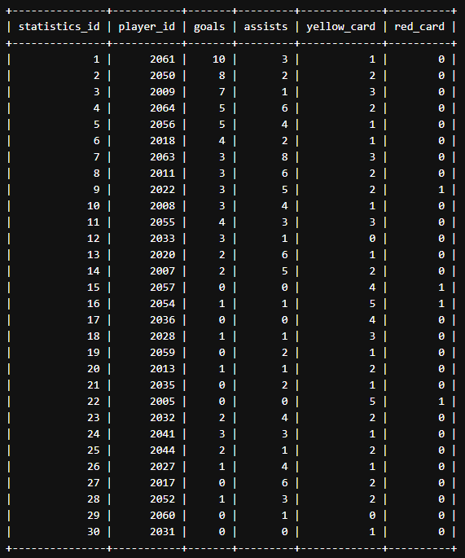
5
Player Statistics Table

Slide 10
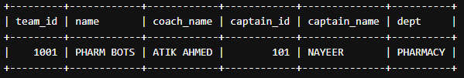
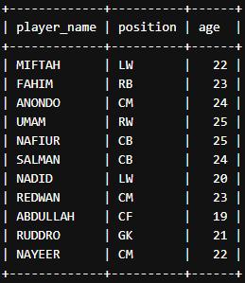
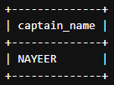
SAMPLE QUERIES
Showing a specific team Details :
SELECT * FROM TEAM WHERE team_id = 1001; to GET TEAM DETAILS OF A TEAM
SELECT captain_name FROM TEAM WHERE team_id = 1001; TO GET CAPTAIN NAME of THAT TEAM
SELECT player_name, position, age FROM PLAYER WHERE team_id = 1001; TO GET PLAYERS IN A THAT TEAM

Slide 11
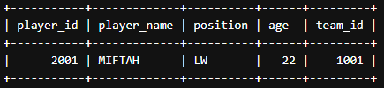
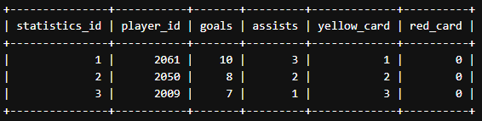
2. Showing A player INFO:
SELECT * FROM PLAYER WHERE player_id = 2001; TO GET A PLAYER DETAILS BY player_id
3. Showing TOP 3 GOAL scorer
SELECT *FROM PLAYER_STATISTICS ORDER BY goals DESC LIMIT 3; -- GET TOP SCORER

Slide 12
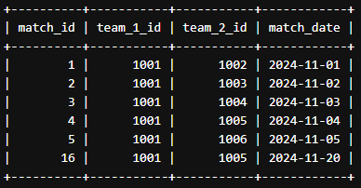
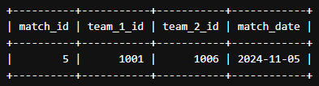
4. Showing A Specific team’s all matches , dates , opponents in selection rounds
SELECT * FROM MATCHES WHERE team_1_id = 1001 OR team_2_id = 1001; -- GET ALL MATCHES FOR A SPECIFIC TEAM
5. Showing a match details like which teams are playing
SELECT * FROM MATCHES WHERE match_id = 5; -- GET MATCH DETAILS BY MATCH ID

Slide 13
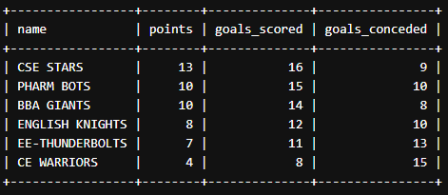

6. Showing league Standing of all teams:
SELECT T.name, LS.points, LS.goals_scored, LS.goals_conceded
FROM LEAGUE_STANDINGS LS
JOIN TEAM T ON LS.team_id = T.team_id
ORDER BY LS.points DESC, LS.goals_scored DESC;
7. Get a specific team’s point throughout the league:
SELECT T.name, LS.played, LS.won, LS.drawn, LS.lost, LS.points
FROM LEAGUE_STANDINGS LS
JOIN TEAM T ON LS.team_id = T.team_id
WHERE T.team_id = 1003;

Slide 14
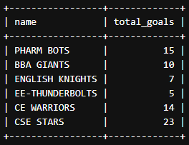
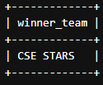

8. Showing The Total Goals OF Each Team
SELECT T.name, SUM(PS.goals) AS total_goals
FROM TEAM T
JOIN PLAYER P ON T.team_id = P.team_id
JOIN PLAYER_STATISTICS PS ON P.player_id = PS.player_id
GROUP BY T.name;
9. Showing You the winner Team
SELECT T.name AS winner_team
FROM LEAGUE_STANDINGS LS
JOIN TEAM T ON LS.team_id = T.team_id
ORDER BY LS.points DESC, (LS.goals_scored - LS.goals_conceded) DESC
LIMIT 1;

Slide 15
Thank you for your attention!
We would be happy to answer any questions you may have about this project.

